Slide 1
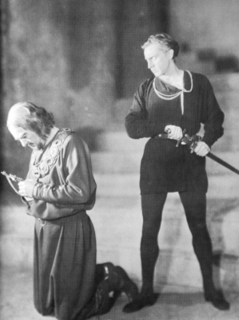
Parent-child relationships in hamlet
By: Kevin, Natalie, Adrian, Fahad and Ahmed

Slide 2
Thesis
The emphasis placed on a parent-child relationship brings a sense of purpose or guidance to a character’s life

Slide 3
Relationships
Polonius and Ophelia
Polonius and Laertes
Hamlet and Ghost (Father)
Hamlet and Claudius
Hamlet and Gertrude

Slide 4
Polonius-Ophelia
Ophelia: “I do not know, my lord, what I should think” (I:iii:104)
Polonius: “Do not believe his vows; for they are brokers” (I:iii:127)
Polonius: “I would not, in plain terms, from this time forth/ Have you so slander any moment’s leisure/ As to give words or talk with the lord Hamlet” (I:iii:132-134)
Ophelia: “I shall obey, my lord” (I:iii:136)

Slide 5
Polonius-Ophelia
Ophelia is naïve and doesn’t know what to think/do
Polonius is telling Ophelia what to do
Ophelia is very obedient

Slide 6
Polonius-Laertes
Polonius: “There; my blessing with thee!/ A these few precepts in thy memory/ See thou character. Give thy thoughts no tongue” (I:iii:57-59)
Polonius: “Give every man thine ear, but few thy voice:/ Take each man’s censure, but reserve thy judgement.” (I:iii:68-69)
Polonius: “Give him this money, and these notes, Reynaldo” (II:i:1)

Slide 7
Polonius-Laertes
Polonius really cares about Laertes
Gives him great advice
Wants to spy on Laertes for his own good

Slide 8
Hamlet-Ghost (Father)
Ghost: “So art thou to revenge, when thou shalt hear” (I:v:7)
Ghost: “Against thy mother aught; leave her to heaven” (I:v:87)

Slide 9
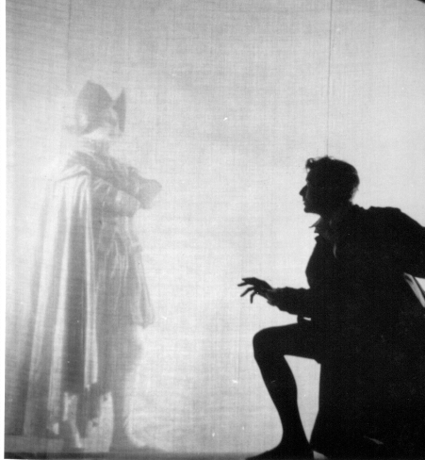
Hamlet-Ghost (Father)
The ghost tells Hamlet his purpose now is to avenge his father’s death
Constantly reminds Hamlet to leave his mother alone

Slide 10
Hamlet-Cladius
Claudius: To do obsequious sorrow: but to persever/ In obstinate condolement is a course/ Of impious stubbornness; ‘tis unmanly grief” (I:ii:92-94)
Claudius: “As of a father: for let the world take note/ You are the most immediate to our throne” (I:ii:108-109)
Claudius: “And with no less nobility of love/ Than that which dearest fathers bears his son/ Do I impart towards you” (I:ii:110-112)

Slide 11
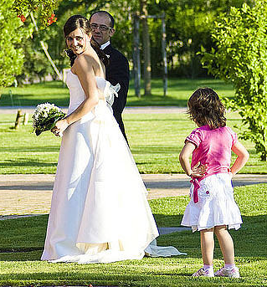
Hamlet-Claudius
Claudius tells Hamlet to get over his father’s death (man up)
Think of his uncle as his father
Hamlet despises him

Slide 12
Hamlet-Gertrude
Gertrude: “I pray thee, stay with us; go not to Wittenberg” (I:ii:119)
Hamlet: “Confess yourself to heaven/ Repent what’s past, avoid what is to come” (III:iv:151-152)
Hamlet: “Good night: But go not to my uncle’s bed” (III:iv:161)
Gertrude: “What shall I do?” (III:iv:183)

Slide 13
Hamlet-Gertrude
Truly cares about his son
Disgusted by his mother marrying right after his father’s death
Hamlet disciplines his mother

Slide 14
Literary Criticism Summary
In the article, “Androgynous ‘Union’ and the Women in Hamlet,” James Stone argues how some characters in Hamlet experience the collapse of sexual difference, which results in unusual actions. Initially, Stone explains how Hamlet shows feminine characteristics through his thoughts, hesitations and actions. Hamlet begins to have suicidal thoughts but when he meets the ghost, Hamlet begins to question the importance of living through many of his soliloquies. These thoughts reveal that Hamlet is indecisive, leading him to hesitate with his plans to kill Claudius. Furthermore, Hamlet has difficulties dealing with his mother’s hasty marriage after his father’s death. Stone describes that a man should adapt to changes, however Hamlet falls into hysteria when he is alone with his mother. The characters in Hamlet act in unexpected ways due to their mentality.
-From the Literary Reference Center

Slide 15
Literary Criticism Commentary
In the article, James Stone emphasizes the importance of a father and son relationship. The article informs us about Hamlet’s unusual behaviour caused by the death of his father. His insanity is further driven by his uncle taking over his father’s throne and marrying his mother. While Hamlet is mentally unstable, he halts his seek for revenge. As a result, we can conclude that the saying “blood is thicker than water” is applicable to this situation. Since the death of his father, Hamlet has lost his male dominance and has caused him to act more feminine and emotionally. In conclusion, the role of a father plays a major impact to a son’s mentality and purpose of life as a son needs a real father—that cannot be replaced.

Slide 16
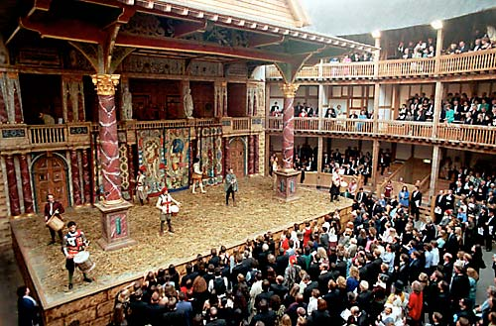
17th Century

Slide 17
2013

Slide 18
quiz time!!!

Slide 19
Quiz #1
Name one thing a parent-child relationship brings to the characters in Hamlet?
Answer: sense of purpose, guidance

Slide 20
Quiz #2
What is Polonius’ advice to Laertes on how to be an honourable man?
Keep his thoughts to himself
Hold on to his old friends but be slow to embrace new friends
To dress richly but not gaudily
All of the above
Answer: d) All of the above

Slide 21
Quiz #3
What does the ghost tell Hamlet to do? (2 things)
Answer: avenge his father’s death and leave his mother alone

Slide 22
Works Cited
Stone, James W. "Androgynous "Union" And The Woman In Hamlet." Shakespeare S tudies 23.(1995): 71. Literary Reference Center Plus. Web. 13 July 2013

Slide 23
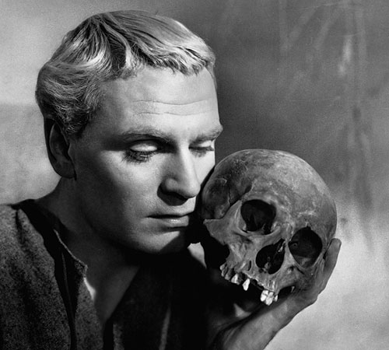
Thank you for listening to our presentation!

