Slide 1
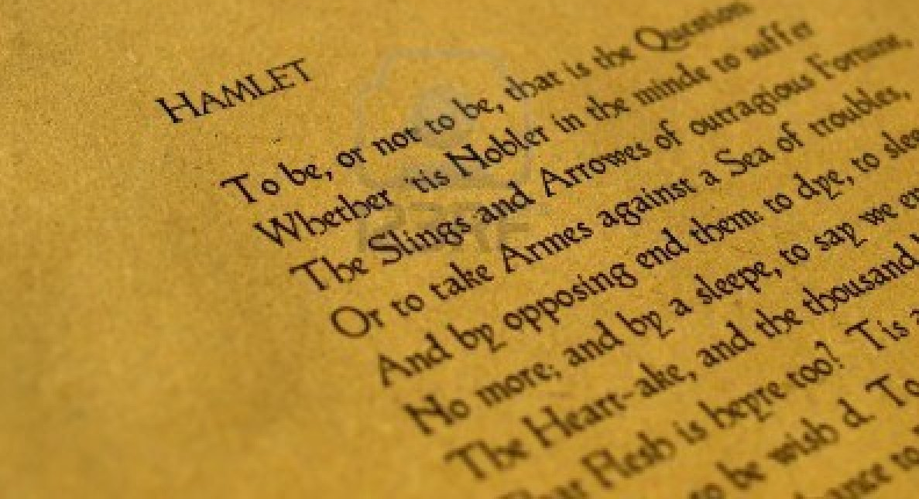
Appearance vs Reality and Deception in Hamlet
Presented by Alisha, Maha, Pranav, Kahil

Slide 2
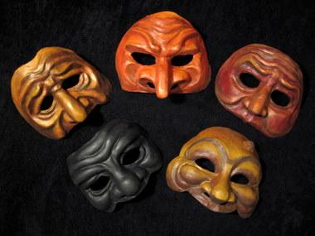
Introduction
Certain characters portray themselves to be sincere and truthful however, they are hidden behind masks of falseness that in the end reveal their lies or negative actions

Slide 3
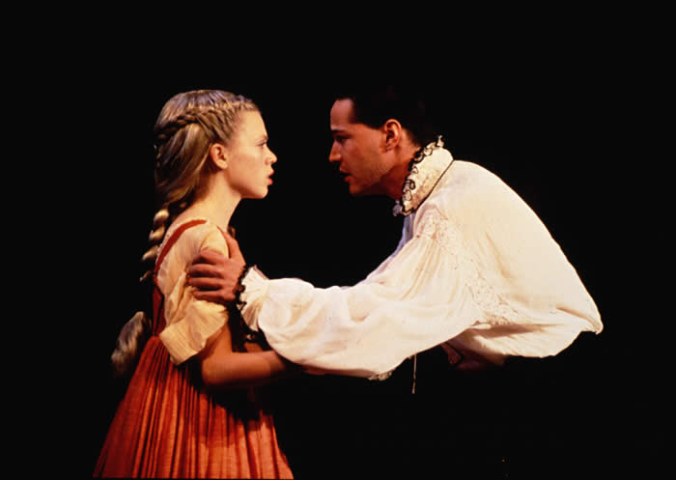
Hamlet
Shows himself as a mad person due to his father’s death, mother’s remarriage to his uncle, and rejection of Ophelia’s love
Reveals himself to be untruthful about his love towards Ophelia
Consequence is that he lost the one he truly loves
“You should have not believed me: for virtue cannot so inoculate our old stock but we shall relish of it: I loved you not.”(III.i. 117-119)
“I loved Ophelia; forty thousand brothers could not, with all their quantity of love, make up my sum.” (V.i.263-265)

Slide 4
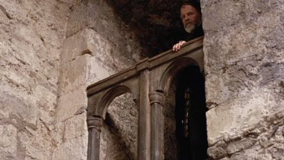
Polonius
Spies on Hamlet’s conversations to try to discover the cause of his madness and to keep him away from Ophelia
Appears to be a loyal chamberlain to the kingdom, but he is actually a person with many evil intentions and is quite deceptive towards Hamlet
“My lord, he’s going to hid mother’s closet: behind the arras I’ll convey myself, to hear the process”(III.iii.28-30)

Slide 5
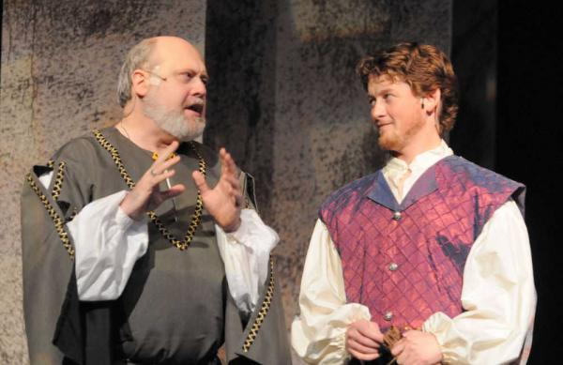
Polonius
Sends Reynaldo to France to spy on his son, Laertes to ensure that he is not doing anything wrong or unethical
This example of spying is a form of deception
In reality Polonius is an untrustworthy and evil man
“Before you visit him, to make inquiry of his behaviour.” (II.i.4-5)
“Ay, or drinking, fencing, swearing, quarrelling, drabbing: you may go so far.” (II.i.25-26)

Slide 6
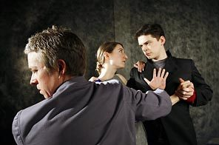
Laertes
Strictly warns Ophelia of Hamlet’s love for her, and tells her to stay away from him
Makes an assumption about Hamlet’s love for Ophelia
Shows deception towards Hamlet
“He may not, as most unvalued persons do, carve for himself, for on his choice depends the safety and the health of the whole state; and therefore must his choice be circumscribed under the voice and yielding of that body where he is the head. Then if he says he loves you, it fits your wisdom so far to believe it” (I.iii.19-25)

Slide 7
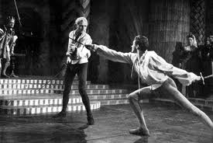
Laertes
Plans with Claudius , Hamlets murder by putting poison on the tip of the sword and battling him in a swordfight
He wants to get revenge on Hamlet due to his fathers death
Appears to be genuine but in reality he is evil since he ends up killing Hamlet with the poison sword
“That is Laertes, a very noble youth: mark.”(V.i.218)
“The treacherous instrument is in thy hand, unbated and envenom’d: the foul practice hath turn’d itself on me,lo, here I lie, never to rise again:thy mother’s poision’d: I can no more: the king’s to blame.”(V.ii.309-313)

Slide 8
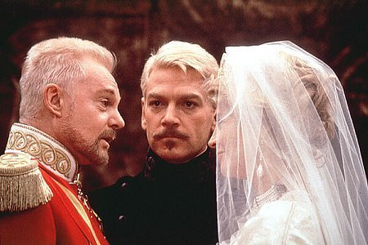
King Claudius
Ambition to acquire the crown of Denmark by killing his brother King Hamlet and marries his sister in law
Pretends to be innocent sorrowful and grieved in front of Hamlet’s awareness
In the end the truth comes out of the horrible deed he performed
“That we with wisest sorrow think on him, together with remembrance of ourselves.” (I.ii.6-7)
“ Give me some light.Away!”(III.ii.264)

Slide 9
King Claudius
Sends Hamlet to England and secretly plans his murder
Appears to be genuine but in reality he is evil due to his negative intensions
“ And he to England shall along with you: the terms of our estate may not endure hazard so dangerous as doth hourly grow out of his lunacies” (III.iii.4-7)

Slide 10
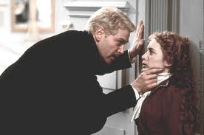
Ophelia
Loves Hamlet but denies it completely, due to her obedience to her father
Leads her to be untruthful about her love to Hamlet
“ My lord, I have some remembrances of yours that I have longed to redeliver. I pray you now receive them”(III.i.95-97)

Slide 11
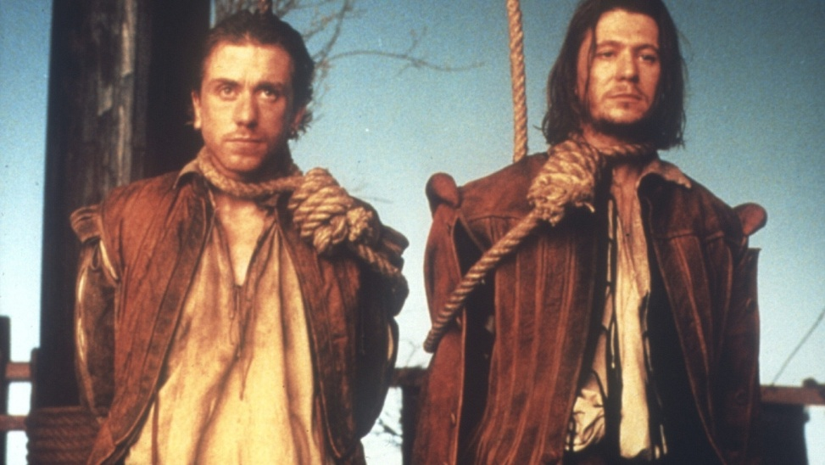
Rosencrantz and Guildenstern
Spy on Hamlet because of the bribe given by Claudius
Try to figure out Hamlet’s cause of madness by keeping a close eye on him
Are killed by England due to Hamlet finding out their secret
Betray their own friend by spying on Hamlet; reality shows them to be untruthful
“Were you not sent for? Is it your own inclining? Is it a visitation? Come, deal justly with me: come, come, nay, speak.” (II.ii.274-276)
“My lord, we were sent for.” (II.ii.292)

Slide 12
Conclusion
Most of the characters in the play Hamlet, played significant roles in deceiving others and not living up to their appearances
All the characters mentioned were hidden behind masks of falseness and did not remain sincere or truthful to their fellow courtiers

Slide 13
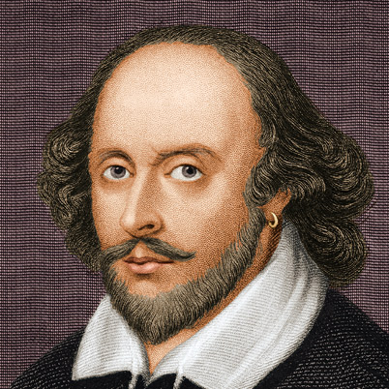
What did we learn?
Learned that people are not what they appear to be
Shakespeare portrays that deceiving leads to negative results

Slide 14
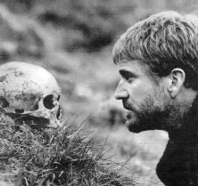
Literary Criticism
Jesting with death: Hamlet in the Graveyard
By Indira Ghose
Ghose, Indira. “Jesting with Death: Hamlet in the Graveyard.” Vol.24. Issue 6 (2010): p1003-1018, 16p. Advanced Placement Source. Web. 14 Jul. 2013.
literary criticism.pdf

Slide 15
Summary
In the article, “Jesting with death: Hamlet in the graveyard” by Indira Ghose, portrays Hamlet’s life to be filled with many identities however in reality, at the end of the play realizes he has no true identity as a person. This journal focuses on a bigger picture of the theme appearance versus reality. The subject matter talks about how Hamlet is not able to find his true identity throughout the play which relates to one of the most famous quotes, “To be or not to be.” Hamlet has troubles finding out what his true identity is. The appearances that Hamlet portrays in the play are a student, courtier, lover, prince, devoted son, friend, madman, theatre-lover, and passionate avenger. However, the most brilliant role he adopts is a court jester. He pretends to be mad and insane as a self protective device. He mocks Polonius, Rosencrantz, Guildenstern, and Ophelia to protect himself. For example when Hamlet tells Rosencrantz to play the recorder even when he doesn’t know how to play, Hamlet mocks him to stand up for himself because he knows his friends are spying on him behind his back. The examples of deception and appearance vs reality in the play, lead Hamlet to become many identities. During the graveyard scene in act 5, when Hamlet is jesting with death, he begins to suspect that he will never discover his true self, and that seems to bring out the reality of his life. Ghose, states “His humour seems to circle obsessively around the fear of the negation of identity in death”. In conclusion, this journal portrays that nothing is what it seems in the world of Hamlet, and thus, the comparison between appearances vs. reality comes in.

Slide 16
Effectiveness
We found this journal effective because it showed proof of our theme of appearance versus reality in a unique way. While reading the journal, the author got us to perceive the theme Appearance versus reality in a different way because it focuses more on character analysis than a specific example in the play. The information that the author portrays is somewhat new to us since she emphasizes greater into the graveyard scene which shows deeper importance to Hamlet’s life. Hamlet appears to be many different identities throughout the play but he never discovers his true self. This article has been of value to us because it gives us a new perspective about the graveyard scene and is more opinionated rather than predictable which gives it a sense of stability. It was definitely written in accessible English and the diction was pretty simple to comprehend. The tone was also quite professional, and therefore, certainly “academic.” In conclusion, this article was overall effective to our theme and it got us to perceive Hamlet’s character in a different way.

Slide 17
References
http://bloggingshakespeare.com/what-to-do-about-hamlet
http://www.canadianshakespeares.ca/essays/reeves.cfm
http://www.fanpop.com/clubs/hamlet/images/2684991/title/hamlet-claudius-gertude-photo
http://www.murphsplace.com/olivier/hamlet2.html
http://torrentbutler.eu/18971-rosencrantz-guildenstern-are-dead
http://melissavizcarra.blogspot.ca/2013/05/more-thoughts-on-hamlet.html
http://itslaertes.wordpress.com/2013/05/19/no-news/
http://sitemaker.umich.edu/ajh.hamlet/home
http://www.123rf.com/photo_5640099_william-shakespeare-s-hamlet-original-middle-english-text-from-the-first-folio-of-1623--selective-fo.html
http://www.experienceproject.com/stories/Wrote-This-In-School/1545888
http://www.theprojectsco.co.uk/pre-employment-screening/
http://hyperion2satyr.blogspot.ca/2010/10/iii-ophelia-affrighted-zeffirelli-90.html

