Slide 1
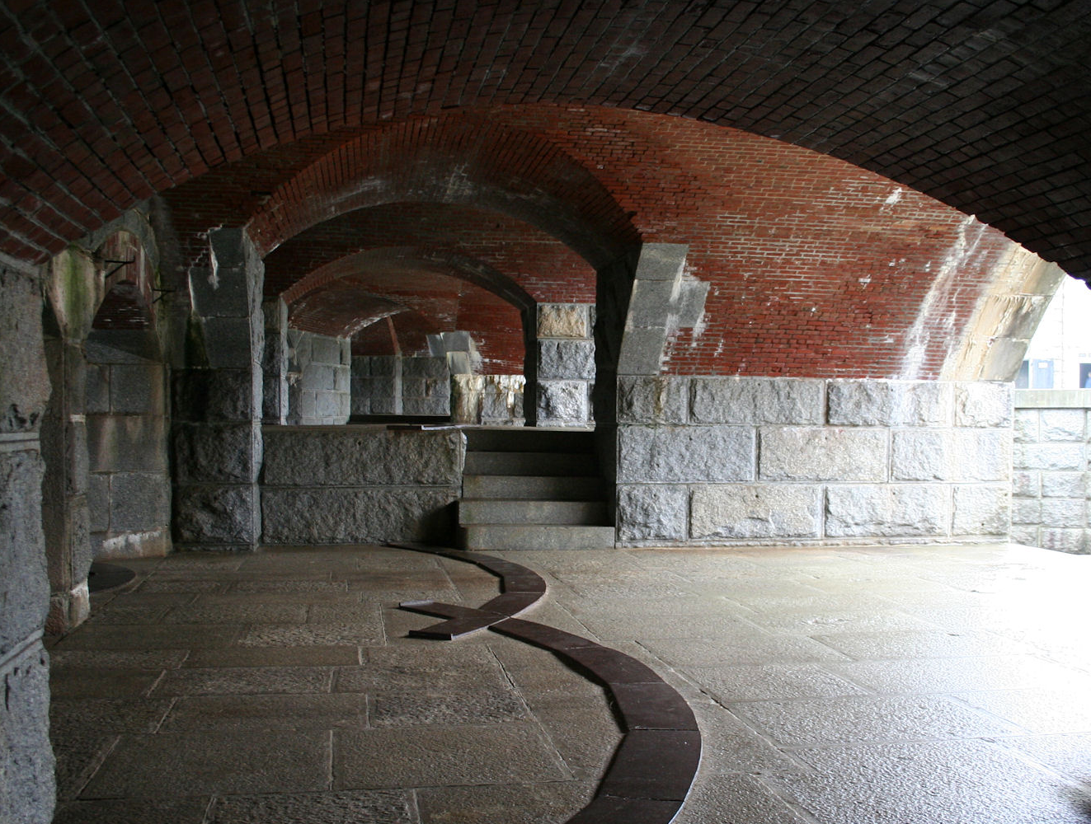
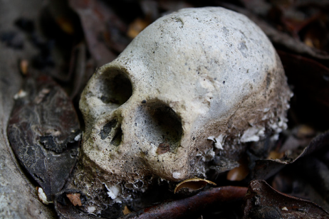
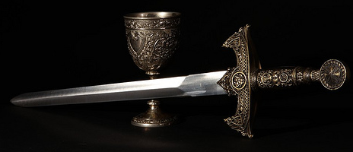
Rotting from Within
Decay
Corruption
By: Esra A., Victoria G., Kyle L., Tre N., and Donna V.
Notes:
Kyle will introduce us and our topic.

Slide 2
Thesis
Theme of corruption and decay
-corruption spreads unceasingly-
Killing King Hamlet, evil Claudius commences a series of murders, killing any challenger who attempts to come between him and his power (the decay factor)
Corrupt dishonest Claudius marries Queen Gertrude and rules Denmark
The deaths of multiple characters are examples of decay caused by corruption.
Notes:
Esra will say
Shakespeare expresses the theme of corruption and decay by showing us that corruption spreads without an end. Claudius rises to power by committing a corrupt deed and thus ruling Denmark based on corruption and dishonesty. By killing the former King, Claudius commences a series of deaths killing anyone who attempts to come in between him and his power, which is the decaying factor. The death of Polonius, Ophelia, Guildenstern, Rosencrantz, Gertrude, Hamlet, Laertes and Claudius are all examples of decay caused by corruption.
Corruption and decay are representative of everyday events in the 14th – 15th century and are exposed in the play, Hamlet.

Slide 3
Act I

Slide 4
Quote
Importance
“Though yet of Hamlet our dear brother’s death
The memory be green, and that it us befitted.”
(I.ii.1)
King Claudius is responsible for the former King Hamlet’s death.
Claudius takes Hamlet’s wife and his crown after marrying Gertrude.
Claudius feels it is best for the kingdom to try and forget King Hamlet
Notes:
Tre will explain the importance.
King Claudius speaks
As we all know, king Claudius is responsible for the former king Hamlet.
Helping himself to Hamlet’s wife and his crown after marriage.
Claudius feels it’s best for the kingdom to try and forget about the former king.

Slide 5
Quote
Importance
“…all that lives must die,
Passing through nature to eternity.”
(I.ii.72-73)
Queen Gertrude tells young Hamlet to stop grieving the loss of his father.
She implies that it is natural for death to occur.
Notes:
Tre will explain the importance.
Queen Gertrude Speaks
Queen Gertrude tells Hamlet to get over the loss of old Hamlet
She also implies that it is natural for death to happen.

Slide 6
Quote
Importance
“A serpent stung me; so the whole ear of Denmark
Is by a forged process of my death
Rankly abused: but know, thou noble youth,
The serpent that did sting thy father’s life
Now wears his crown.”
(I.v.36-40)
Example of corruption
Claudius is the serpent
The story of King Hamlet’s death in Denmark is false.
Claudius murders his own brother for the crown
Claudius seizes the crown through a corrupt deed
The state of Denmark is ruled by corruption
Notes:
Esra will explain the importance.
The ghost of king Hamlet speaks.
Example of corruption
Claudius is the serpent
The story of King Hamlet’s death in Denmark is false, Claudius murders his brother for the crown
Claudius seizes the crown through a corrupt deed
Thus the state of Denmark is ruled by corruption

Slide 7
Quote
Importance
“Something is rotten in the state of Denmark.”
(I.vi.90)
Foreshadows events to come
In the beginning, the characters notice that something is wrong
Corruption starts at the royal family and spreads to the rest of the country
Notes:
Kyle will explain the importance.
Marcellus
Foreshadows events to come
In the beginning, the characters notice that something is wrong
Corruption starts at the royal family and spreads to the rest of the country
s speaks.

Slide 8
Act II

Slide 9
Quote
Importance
“ Excellent well; you are a fishmonger” (II.ii.172)
“…truly in my youth I suffered much extremity for love”
(II.ii.187-188)
Hamlet challenges Polonius’ honesty
Polonius admits that he had sexual issues in his youth
Fishmongers are corrupt (thought to be ‘pimps’)
Notes:
Donna will explain the importance.
Hamlet speaks with Polonius.
Hamlet challenges Polonius’ honesty
Polonius admits that he had sexual issues in his youth
This action goes against society’s values
Fishmongers are corrupt (thought to be ‘pimps’)

Slide 10
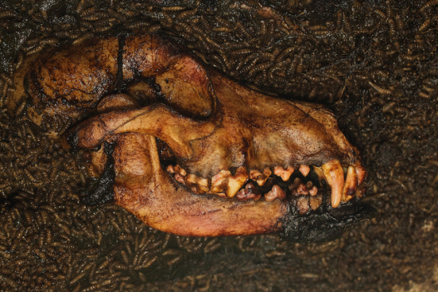
Quote
Importance
“For if the sun breed maggots in a dead dog, being a god kissing carrion…”
(II.ii.179 – 180)
The sun god’s kiss causes the maggots to actively decompose the dog’s body
Corruption - dog’s body is corrupt (breaking down body)
Decay - maggots break down the dog’s body
Notes:
Donna will explain the importance.
Hamlet speaks.
The sun god’s kiss causes the maggots to actively decompose the dog’s body
Corruption - dog’s body is corrupt (breaking down body)
Decay - maggots break down the dog’s body

Slide 11
Act IV

Slide 12
Quote
Importance
“Not where he eats, but where he is eaten: a certain
convocation of politic worms are e’en at him.”(IV.iii.20-21)
Imagery of decay
This is Hamlet’s reply when asked by Claudius about the whereabouts of Polonius’ body.
Hamlet is talking about the worms eating Polonius’ body; the body is decomposing
Reflects on the state of Denmark
Notes:
Esra will explain the importance.
Hamlet speaks.
Imagery of decay
This is Hamlet’s reply when asked by Claudius about the whereabouts of Polonius’ body.
Hamlet is talking about the worms eating Polonius’ body thus the body is decomposing
The worms represent evil people in Denmark.
Reflecting on the state of Denmark – this is the first murder by young Hamlet. This scene foreshadows future murders.

Slide 13
Quote
Importance
“The present death of Hamlet. Do it, England; For like the hectic in my blood he rages, And thou must cure me: till I know 'tis done, Howe'er my haps, my joys were ne'er begun.”
(IV.iii.66-69)
Example of corruption
Claudius sends Hamlet to England for execution
Partaking in murder is evil and corrupt
Notes:
Tori will explain the importance.

Slide 14
Quote
Importance
“poor Ophelia,
Divided from herself and her fair judgment,
Without the which we are pictures, or mere beasts:”
(IV.v.82-84)
Claudius expresses without our sanity we are just animals
Decay – Ophelia’s mental health decays after the loss of her father Polonius
False love from Hamlet
Notes:
Kyle will explain the importance.
Claudius speaks.

Slide 15
Act V

Slide 16
Quote
Importance
“Take up the bodies: such a sight as this Becomes the field, but here shows much amiss. Go, bid the soldiers shoot.” (V.ii.393-396)
Example of decay
Fortinbras explains how the scene looks like a battlefield
People died in succession
Everything fell apart
Notes:
Tori will explain the importance.

Slide 17
Literary Criticism Summary
Hamlet: Not a World of His Own
The article the group has chosen discusses Hamlet’s hesitation and inability to take action to avenge his father’s death. The author of the essay talks about Hamlet’s civility and decency. Often Hamlet hesitates to seek revenge. The causes of this are his self-conflicts and psychological health. Hamlet tries to determine whether the ghost that appears is not satanic, causing him conflict. The ghost of King Hamlet appears, asking for revenge symbolizing impurity and corruption. For Hamlet to lawfully seek revenge on Claudius, he needs proof that Claudius is guilty of his father’s death. Hamlet uses the play within a play to poke at Claudius’ conscience. Hamlet does not want to seek revenge specifically by murder, but hoping Claudius would repent of his sins and abdicate the throne. Claudius’ reaction to the play proves that he is guilty. The reader is able to visualize Claudius attempting to pray but says his “words fly up my thoughts remain below”(III.iii.98).
Claudius is unremorseful and his state of mind is too corrupt to give up what he has acquired. King Claudius is the reason for the decay and corruption of the state of Denmark and he rules with passion, thus his corruption is unrestrained. Hamlet’s love for Ophelia makes him feel that he has fallen victim to the “very ecstasy of love” which drives him to madness. Hamlet hesitates to seek revenge because he does not know if his mother, Gertrude was involved in the murder of King Hamlet. The audience can conclude that young Hamlet’s primary goal is to restore order to the state of Denmark. Through analysis the audience understands that Hamlet is not corrupt. He hopes that Claudius would repent and relinquish the throne. Because Claudius did not, Hamlet purges Denmark by killing Claudius and ends the sequence of corruption and decay.
Notes:
Esra will explain.

Slide 18
Literary Criticism Analysis
This article is useful for the reader’s understanding of the play because it demonstrates that there is much decay and corruption written in Hamlet. The article describes how King Claudius is corrupted by his greed and ambition, which, combined with his unrestrained passion, results in the decay of the state of Denmark. It also helps us comprehend that a part of Hamlet is not corrupt which is what is holding him back from killing Claudius however as the play continues Hamlet breaks don and kills the king proving the theme of decay. The article helps us see that corruption and decay is, in fact, a huge part of the play.
Notes:
Tori will explain.

Slide 19
Conclusion
How deep is the element of corruption in the state of Denmark?
Corruption is very sinister and is nearly impossible from which to recover but victory triumphs over evil.
Notes:
Tre will explain.

Slide 20
Conclusion
Are the characters subjected to an already unhealthy environment?
Yes. Claudius created a ripple effect and a toxic environment.
Are specific characters the cause of corruption?
Yes. Claudius and Laertes are the causes of corruption and decay.
Notes:
Kyle will explain.

Slide 21
Conclusion
Claudius rules corruptly which leads to the decay of the kingdom of Denmark.
Corruption = Decay
‘The end justifies the means’ (Hamlet kills Claudius to purge corruption and decay.)
Notes:
Tori will explain.

Slide 22
Apple decaying Video slide
Notes:
Donna will explain.

Slide 23
Works Cited
Goldstein, Philip. "Shakespeare Studies." Hamlet:
Not a World of His Own 13 (1980): 71+. Print.
Shakespeare, William. Hamlet Second Edition. Ed.
Marilyn Eisenstat and Ken Roy. Toronto:
Harcourt Canada, 2004. Print.
www.youtube.com/watch?v=w7gixDxKfjo

